Slide 1
Programming for problem solving
SEMESTER: 1st
PREPARED BY: Prof. Sagar Patel

Slide 2
CHAPTER 6 TOPIC 1 & 2
C Recursion
How recursion works?
Example programs
Finding Factorial
Fibonacci series
Ackerman function

Slide 3
Recursion
Recursion is the process of repeating items in a self-similar way. In programming languages, if a program allows you to call a function inside the same function, then it is called a recursive call of the function.

Slide 4
Recursion
void recursion()
{
recursion();
/* function calls itself */ }
int main()
{
recursion();
}

Slide 5
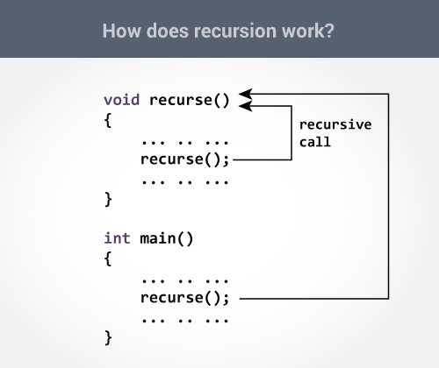
Recursion

Slide 6
Recursion EXAMPLES (Finding Factorial)
The following example calculates the factorial of a given number using a recursive function
#include <stdio.h>
unsigned long long int factorial(unsigned int i) {
if(i <= 1) {
return 1;
}
return i * factorial(i - 1);
}
int main() {
int i = 12;
printf("Factorial of %d is %d\n", i, factorial(i));
return 0;
}

Slide 7
Recursion EXAMPLES (Finding Factorial)
When the above code is compiled and executed, it produces the following result
Factorial of 12 is 479001600

Slide 8
Recursion EXAMPLES (Fibonacci series)
The following example generates the Fibonacci series for a given number using a recursive function
#include <stdio.h>
int fibonacci(int i) {
if(i == 0) {
return 0;
}
if(i == 1) {
return 1;
}

Slide 9
Recursion EXAMPLES (Fibonacci series)
return fibonacci(i-1) + fibonacci(i-2);
}
int main() {
int i; for (i = 0; i < 10; i++) {
printf("%d\t\n", fibonacci(i));
}
return 0;
}

Slide 10
Recursion EXAMPLES (Fibonacci series)
When the above code is compiled and executed, it produces the following result
0
1
1
2
3
5
8
13
21 34

Slide 11
Recursion EXAMPLES (Ackerman function)
The Ackermann function is the simplest example of a well-defined total function which is computable but not primitive recursive, providing a counterexample to the belief in the early 1900’s that every computable function was also primitive recursive . It grows faster than an exponential function, or even a multiple exponential function.

Slide 12
Recursion EXAMPLES (Ackerman function)
#include<stdio.h>
int A(int m, int n);
main()
{
int m,n;
printf("Enter two numbers :: \n");
scanf("%d%d",&m,&n);
printf("\nOUTPUT :: %d\n",A(m,n));
}

Slide 13
Recursion EXAMPLES (Ackerman function)
int A(int m, int n)
{
if(m==0)
return n+1;
else if(n==0)
return A(m-1,1);
else
return A(m-1,A(m,n-1));
}

Slide 14
Recursion EXAMPLES (Ackerman function)
Output:
************* FIRST RUN ***********
Enter two numbers ::
1
0
OUTPUT :: 2
************* SECOND RUN ***********
Enter two numbers ::
0
5
OUTPUT :: 6

